Slide 1
Micro Musician
Mission 5

Slide 2

Pre-Mission Preparation
In the Mission 5 log, answer the pre-mission preparation questions:
What are some ways a musician uses a computer to make music?
How do you want to use music or sound in a CodeX program?

Slide 3
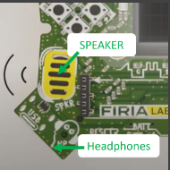
Objective #1: Sound outputs
There are two ways to listen to sound on the CodeX.
Built-in speaker
Plug in headphones
The CodeX uses a codec chip to change digital information into audio sound waves.

Slide 4
Objective #1: Sound outputs
With code you can:
Play sound files
Beep tones
Control volume
And more!

Slide 5
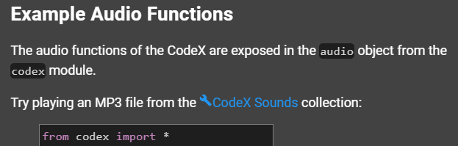

Mission Activity #1
DO THIS:
Click on to add it to your toolbox
Scroll down in the toolbox until you find
Click on it and find the table with all the CodeX built-in sounds
In your Mission Log, write down the names of sounds that you want to try

Slide 6
Mission Activity #1
Find the speaker and headphone jack.
DO THIS:
Close the instruction panel
Use camera controls to rotate the CodeX in the scene
Click on the speaker
Click on the headphone jack

Slide 7

Objective #2: Micro tunes
Now it is time to write code to play some sounds.
Start by playing an mp3 file.
An mp3 is just an audio file in the mp3 format
The CodeX has a few sample mp3 files already loaded
Here is an example:

Slide 8
Mission Activity #2
DO THIS:
Create a new file called Music1
Type code to play an mp3 file
You can use the one in the example, or pick a file from the sounds your are interested in trying
Run the code

Slide 9
Objective #3: Clean codes
Good code is easy to read by people.
As your programs get longer, you can do a few things to keep them readable:
Use blank lines to separate sections of code
  The computer ignores blank lines
Add comments that explain what the code does
  The computer ignores comments

Slide 10

Mission Activity #3
DO THIS:
Add a blank line to your code
Run the code

Slide 11
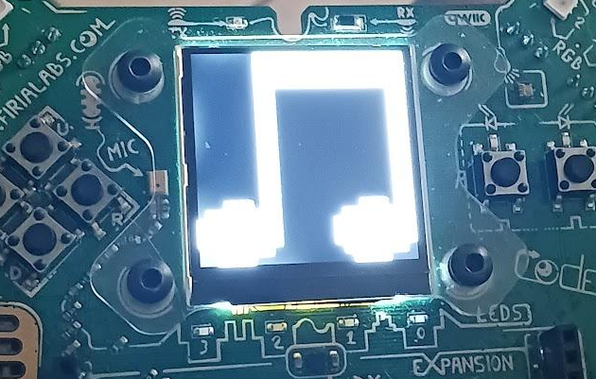
Objective #4: Once more, with feeling
You don’t want the screen to be blank when the sounds are playing.
You can use display.show() with an image
Use this statement BEFORE playing the mp3 file

Slide 12
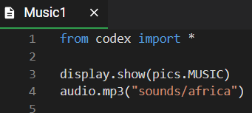
Mission Activity #4
Add an image to your code
DO THIS:
Add display.show(pics.MUSIC)
Change the audio file to “sounds/africa”
Run your code
Answer the question on the Mission Log

Slide 13
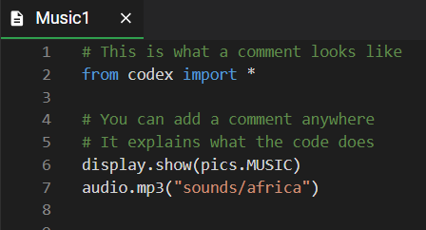
Objective #5: Comments
Making code readable to people was mentioned in Objective 3.
You already learned about blank lines. Now let’s find out about comments.

Slide 14
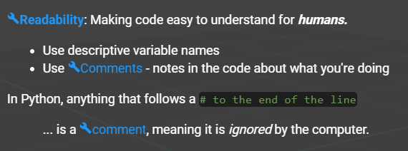

Mission Activity #5
DO THIS:
The instruction panel defines two words:
  Readability
  Comments
Write the definitions in your Mission Log
Click on to add it to the toolbox

Slide 15
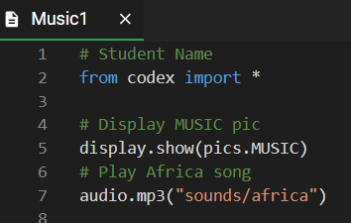
Mission Activity #5
Add three comments to your code
DO THIS:
Add a comment with your name at the top of your code (line 1)
Add a comment before the display.show() statement (line 4)
Add a comment before the audio.mp3() statement (line 6)
Run the code

Slide 16

Sounds and Readable quiz
During this mission you have learned about playing audio files and making your code readable.
Answer the 2 quiz questions
CODEX
QUIZ

Slide 17
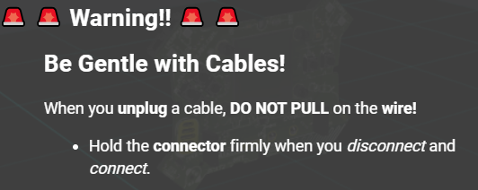
Objective #6: Portable mp3s
After the code is running on the CodeX, you can go unplugged.
After you run a program, it is loaded on the CodeX
You can unplug the CodeX from the computer and run on batteries

Slide 18
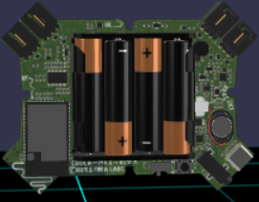
Mission Activity #6
DO THIS:
Close the instruction panel
Use camera controls to rotate the CodeX in the scene
Click on the BATT switch

Slide 19
Mission Activity #6
(OPTIONAL)
DO THIS:
Put batteries the CodeX
Unplug from the computer
Flip the BATT switch to position 1
Enjoy your CodeX “unplugged”!

Slide 20
Post-Mission Reflection
Read the “completed mission” message and click to complete the mission
Complete the Mission 5 Log

Slide 21
Clearing your CodeX
Go to FILE -- BROWSE FILES
Select the “Clear” file and open it
Run the program to clear the CodeX

